Slide 1
MOVIE TICKET BOOKING SYSTEM
BY: AINEMBABAZI KISHA LIANA.
S19B23/085
A87133

Slide 2
Carpe diem. Seize the day, boys. Make your lives extraordinary.
-Dead Poets Society, 1989.

Slide 3
Background
This system is being built to simplify booking movie tickets in cinemas in Uganda.
Most cinephiles consider booking movie tickets for blockbusters showing in Ugandan cinemas tedious because it must be done personally rather than remotely, as most service providers in today's marketplace do.

Slide 4
Mission.
The main objective of the movie ticket booking system is to manage the details of Seats, Booking, Customers and Payments in order to provide a user friendly interface to allow users to book movie tickets remotely.

Slide 5
Features of the system
Search
Provision of a search bar for the various facilities i.e.: Seats and screening movies.
Payments
Transactions are executed offline via Mobile money and visa payment modes
Database
The system tracks all information with regard to booking, the movies available, seating and payments
Reports
The system generates reports from the different modules i.e.: Booking, Movies available and Seating.
It also provides filter reports on customer and payments
Validation
The system ensure security through validation of users via multifactor authentication.
Reservations
The purpose of this system is to cut down on the manual work for managing seating

Slide 6
SWOT Analysis
STRENGTHS
Ease of access to movie tickets and improved convenience
Time saving
WEAKNESSES
Requires a good internet connection
Requires a device with access to the internet
S
W
The lack of existing ticket booking system in Uganda OPPORTUNITIES
Regular down times which eventually affect the available market for the product.
THREATS
O
T

Slide 7
Roadmap
Write the Project proposal
Present a Business Pitch to the interested parties
Build and develop the Movie Ticket Booking System
1
3
5
2
4
6
Perform a feasibility Study and provide the requirements specification document
Upon convincing the investors, Perfom the system analysis and design to proceed with developement
Delivery of the final product.

Slide 8
Languages and technologies used in this Project
Front-end
HTML
CSS
JavaScript.
Visual Studio-Code (both)
Backend
Python3
Django
MySQL

Slide 9
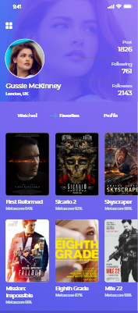
Mobile project

Slide 10
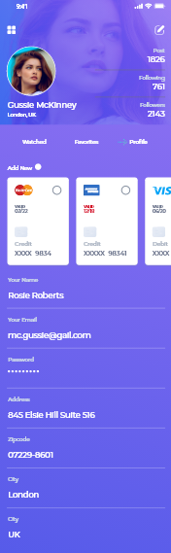
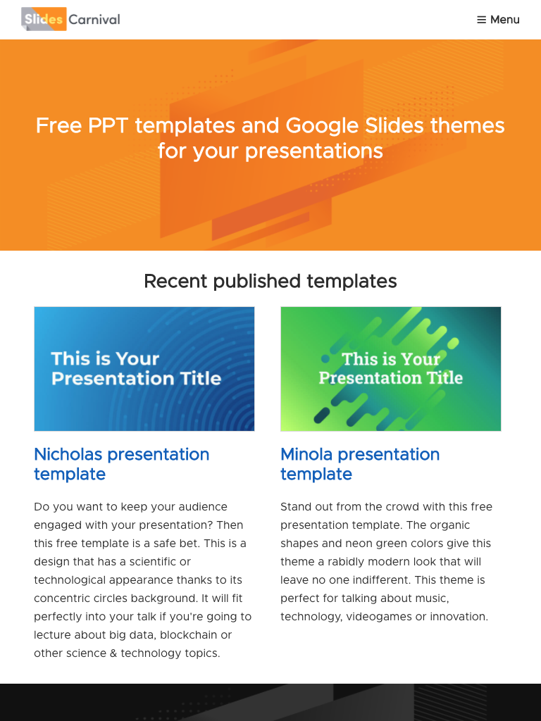
Tablet project

Slide 11
Thanks!
Any questions?

Slide 12
“May the Force be with you.”
-Star Wars, 1977

